Slide 1

E6893 Big Data Analytics:
Relationship among Crimes, Commuters and Sentiment in Manhattan
Project ID: 201812-9
Team Members (with UNI): Yunan Lu (yl4021)
Zhicheng Ding (zd2212)
Lin Bai (lb3161)

Slide 2
Outline
Motivation
Data Analysis – Dataset, Algorithm, Tools
Commuters
Taxi
Subway
Crimes
Sentiment
Twitter
Pearson Correlation
Visualization
Web UI (Heatmap plot, Bubble plot, Statistic plot)

Slide 3
Motivation
Every day, large amount of people travel via public transportation (e.g., taxi, subway). At the same time, crimes happens everywhere.
Does it exist any pattern between the number of commuters and the frequency of crimes?
Whether people’s sentiment reflect the trend of crimes during the day among the week?

Slide 4
Data Collection and Pre-processing
Backend – Data Processing
Web Frontend - Visualization
Data Mining
Aggregation (Coordinate)
Heatmap Chart
Data Warehouse
Datasets
Aggregation (Precinct)
Crime
Subway
Twitter
Bubble Chart
Precinct Info
Taxis
Corpus
Linear Regression & Correlations
Data Cleanup & Feature Extraction
Natural Language Processing
Statistic Chart

Slide 5
Crime aggregated by precinct
Day
Hour
Precinct
Aggregate data by precinct
Crime
(53MB)
Id
Timestamp
Precinct
Coordinate
Extract Features
Crime aggregated by coordinate
Day
Hour
Coordinate
Aggregate data by coordinates (step 0.001)
Commutes aggregated by precinct
Day
Hour
Precinct
Aggregate data by precinct
Commutes
(subway, taxis)
(26GB)
Id
Timestamp
# of passenger
Coordinate
Extract Features
Calculate coordinates locates to which precinct
Commutes aggregated by coordinate
Day
Hour
Coordinate
Aggregate data by coordinates (step 0.001)
Sentiment
(Twitter)
(313.7GB)
id
Timestamp
Context
Location
Sentiment of Manhattan
Day
Hour
Positive
Negative
Extract Features
Select tweets in Manhattan and extract features
Natural Language Processing

Slide 6
Precinct Geojson
Crime aggregated by precinct
Day
Hour
Precinct
Heatmap Chart
Crime aggregated by coordinate
Day
Hour
Coordinate
# of residents
Precinct Geolocation
Commutes aggregated by precinct
Day
Hour
Precinct
Bubble Chart
Commutes aggregated by coordinate
Day
Hour
Coordinate
Statistic Metrics
Sentiment of Manhattan
Day
Hour
Positive
Negative
Statistic Chart

Slide 7
Commuters - MTA
Dataset (900MB)
Turnstile Data (Subway) – http://web.mta.info/developers/turnstile.html
Data range: Jan 04, 2014 – Jan 03, 2015
Dataset Description
Main info: it contains the inflow and outflow of each subway station.
Attributes:
Id
Timestamp
Population
Entry or Exit
Station location – http://web.mta.info/developers/data/nyct/subway/Stations.csv
Connection between Turnstile Data and Station location –http://web.mta.info/developers/turnstile.html

Slide 8
Commuters - MTA
Data clean-up
Normalized the turnstile table before and after Oct. 11 with the same format
Match the station location table with the turnstile table based on the station name
Standardized the “TIME” column’s value
Calculated the hourly enter and hourly exit number
Aggregate the data into a week.
Calculate each point belong to which precinct and then group by precinct.
Tools
Python: Pandas, Numpy

Slide 9
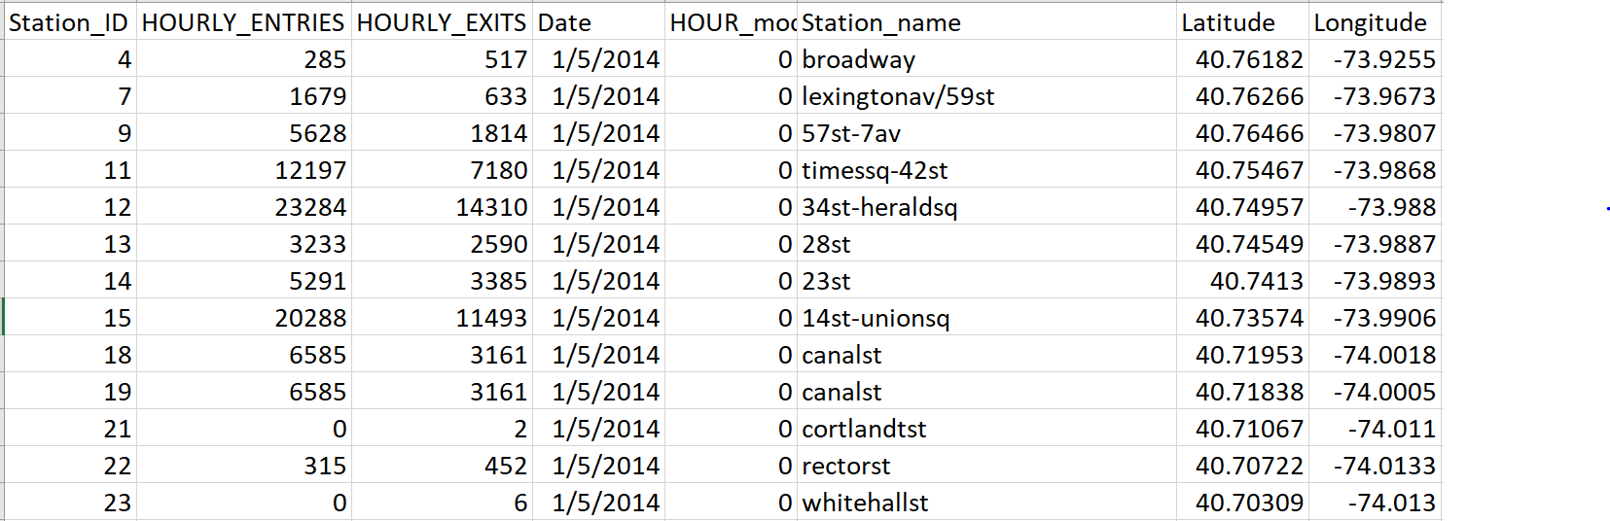
MTA - Result

Slide 10
Commuters - Taxi
Dataset (25GB)
2014 Yellow Taxi Trip Data – https://data.cityofnewyork.us/Transportation/2014-Yellow-Taxi-Trip-Data/gn7m-em8n
Dataset Description:
Yellow Taxi normally cover most area in Manhattan
Attributes:
Id
Timestamp
# of Passenger
Coordinate

Slide 11
Commuters - Taxi
Data clean-up
Simplify the dataset columns to timestamp, # of passenger, coordinate.
Iteratively manipulated dataset to standardized the datetime format and add corresponding weekday and hour.
Aggregate the # of passenger based on the location which is achieved by slicing the latitude and longitude with a stepsize [0.001]
Calculate each point belong to which precinct and then group by precinct.
Tools
Python: Pandas, Numpy
Google Cloud: By using compute engine with large memory size to avoid “OutofMemory” issue when manipulating large dataset

Slide 12
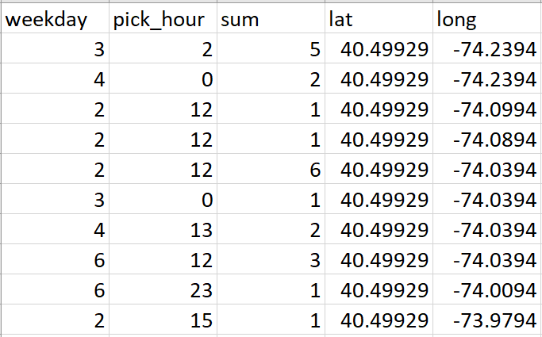
TAXI - Result
After data clean-up steps, the original dataset of 25GB were shrank into 45MB

Slide 13
Crimes
Dataset (53MB)
2014 New York City Crimes – https://www.kaggle.com/adamschroeder/crimes-new-york-city#Crime_Column_Description.csv
Dataset Description:
2014-2015 Crimes reported in all 5 boroughs of New York City
Attributes:
Id
Timestamp
Precinct number
Coordinate

Slide 14
Crimes
Data clean-up
Simplify the dataset to weekday, hour, precinct, latitude, longitude
Aggregated the data based on precinct number.
Aggregate the number of precinct based on the location which is achieved by slicing the latitude and longitude with a stepsize [0.001]
Tools
Python: pandas, numpy

Slide 15
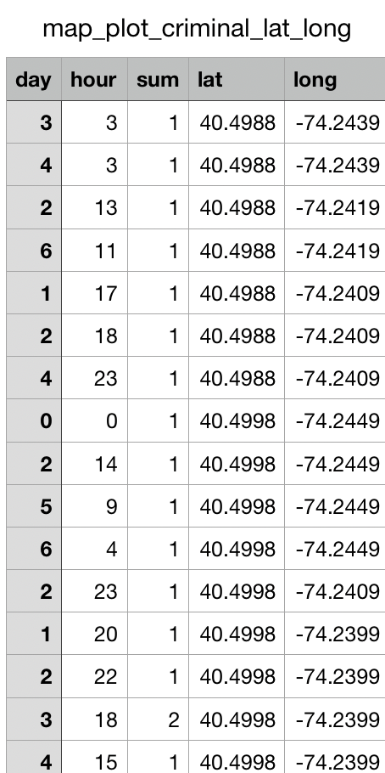
Crimes Result

Slide 16
Sentiment
Dataset (total: 313.7GB)
2014 Twitter Dataset – https://archive.org/details/twitterstream?and[]=year%3A%222014%22
Dataset Description:
Twitter post of all year
Attributes:
Context
Timestamp
User
Description
Location

Slide 17
Sentiment
Data clean-up
Simplify the dataset to weekday, hour, precinct, latitude, longitude
Aggregated the data based on precinct number.
Aggregate the number of precinct based on the location which is achieved by slicing the latitude and longitude with a stepsize [0.001]
Tools
Python: pandas, numpy, GCP, NLP

Slide 18
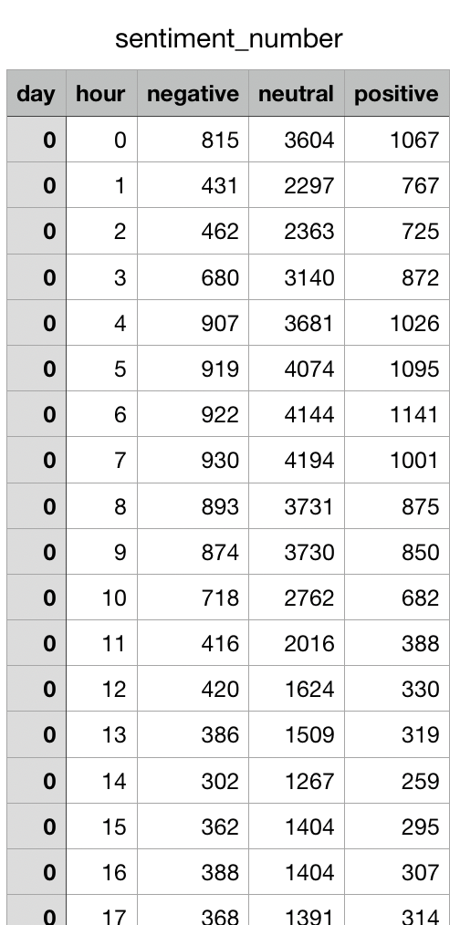
Sentiment Result

Slide 19
Pearson Correlation
In statistic, the Pearson correlation coefficient (PCC) is a measure of the linear correlation between two variables crimes and commuters.
* Ref: https://en.wikipedia.org/wiki/Pearson_correlation_coefficient

Slide 20
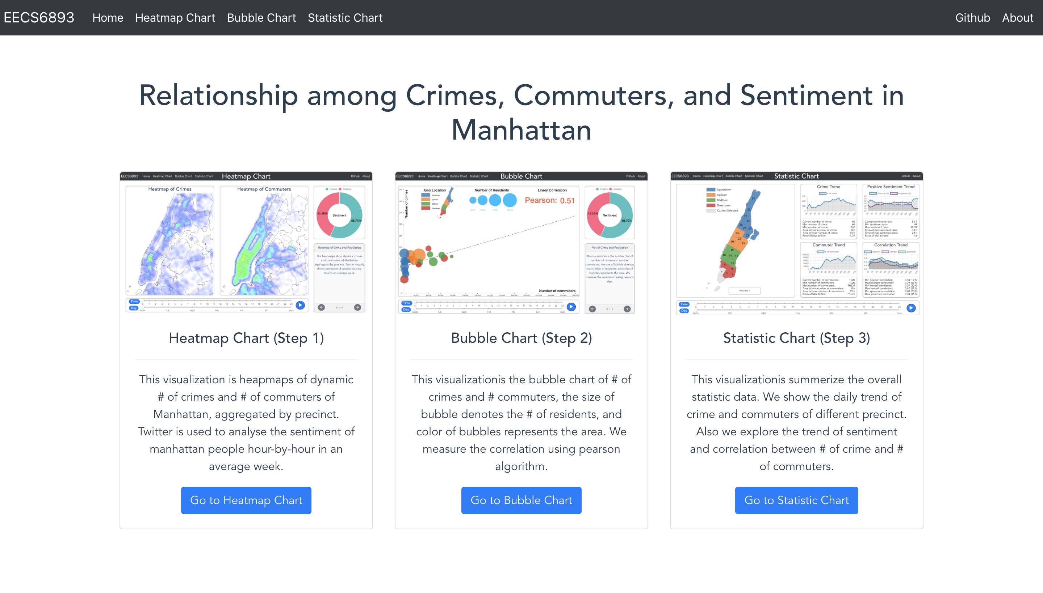
Demo
Link: http://35.231.39.145:8080/

Slide 21
Algorithms & Tools
Algorithms:
Natural Language Processing
Calculate point inside/outside polygon
Calculate geo center of polygon
Linear Regression
Pearson Correlation
Kendall Correlation
Spearman Correlation
Tools:
Google Cloud Platform
Pandas
Numpy
Vue.js
D3.js

Slide 22
Conclusion
From the map chart, we can see that there are more commuters and crimes in downtown and midtown, but relatively less in uptown and upper town.
From the bubble chart, we found that downtown, midtown, and uptown have relatively high frequency of criminal and high traffic density during work hour. It gradually reduces to normal at midnight.
From the Pearson correlation calculated, we can see that the number of crimes and commuters are linearly positive correlated (about 0.5).
From the sentiment analysis, we can see that for the weekdays, people normally more negative for the work hours and positive for the night. While for the weekend, people would be more positive all the day which may result in safety awareness decreasing and lead number of crimes increase.

Slide 23
Q & A
Youtube Link: https://youtu.be/XA7PlJ9USqc

Slide 24
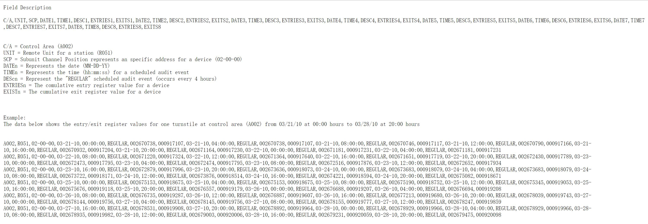
Appendix – Data Clean-up Process
Dataset before Oct 11
This is a flat dataset with multiple (DATE, TIME, ENTRIES, EXITS) columns without station name
Convert into long dataset

Slide 25
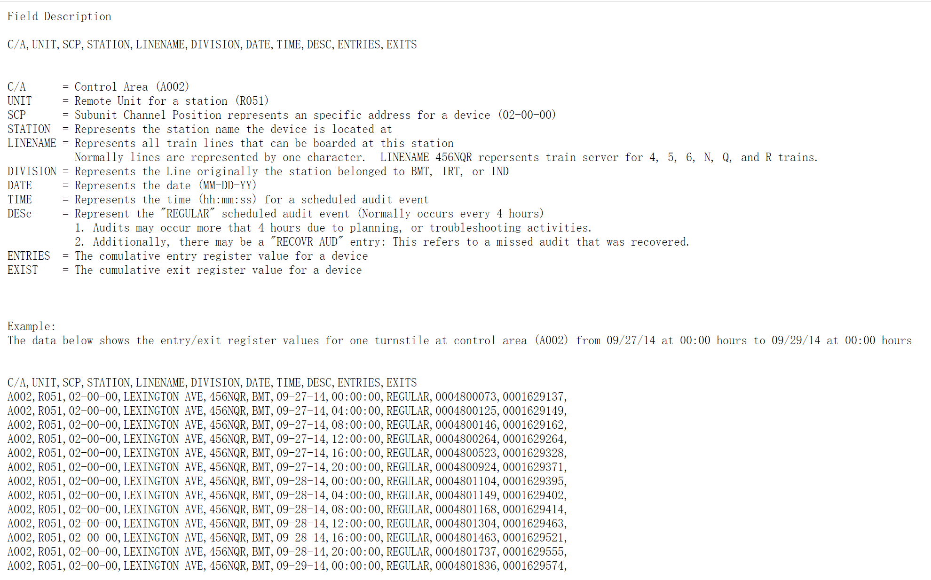
Dataset after Oct 11
This is a long dataset with station name

Slide 26
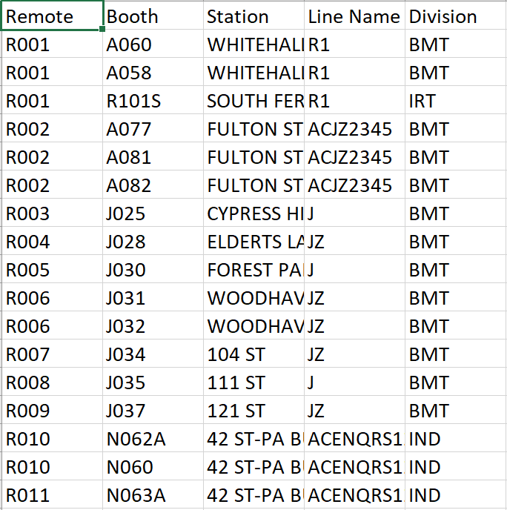
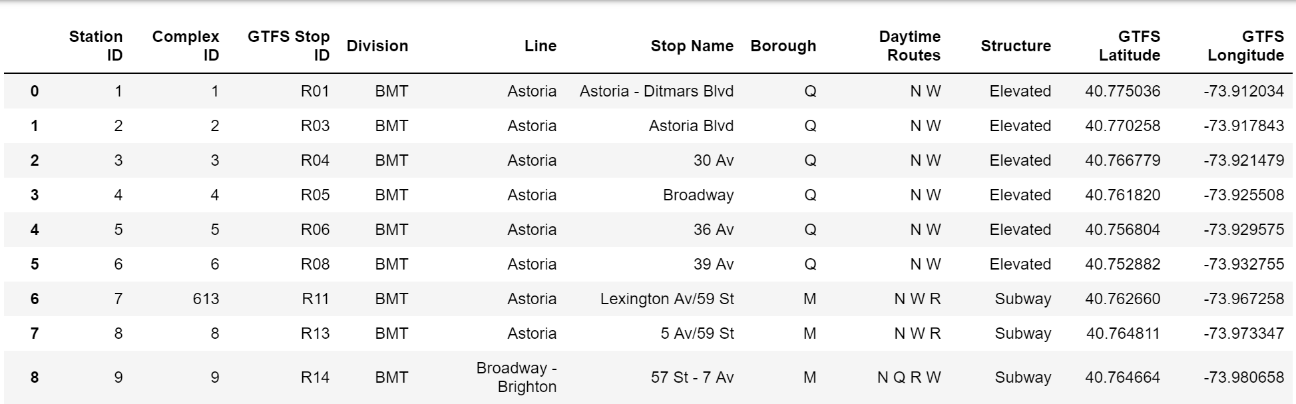
Station location
Problem:
These two table do not have common columns, the station name are not exactly the same, so we need to find the most common parts from multiple columns to join these two table together.
Remote Unit / Control Area / Station Name Key

Slide 27
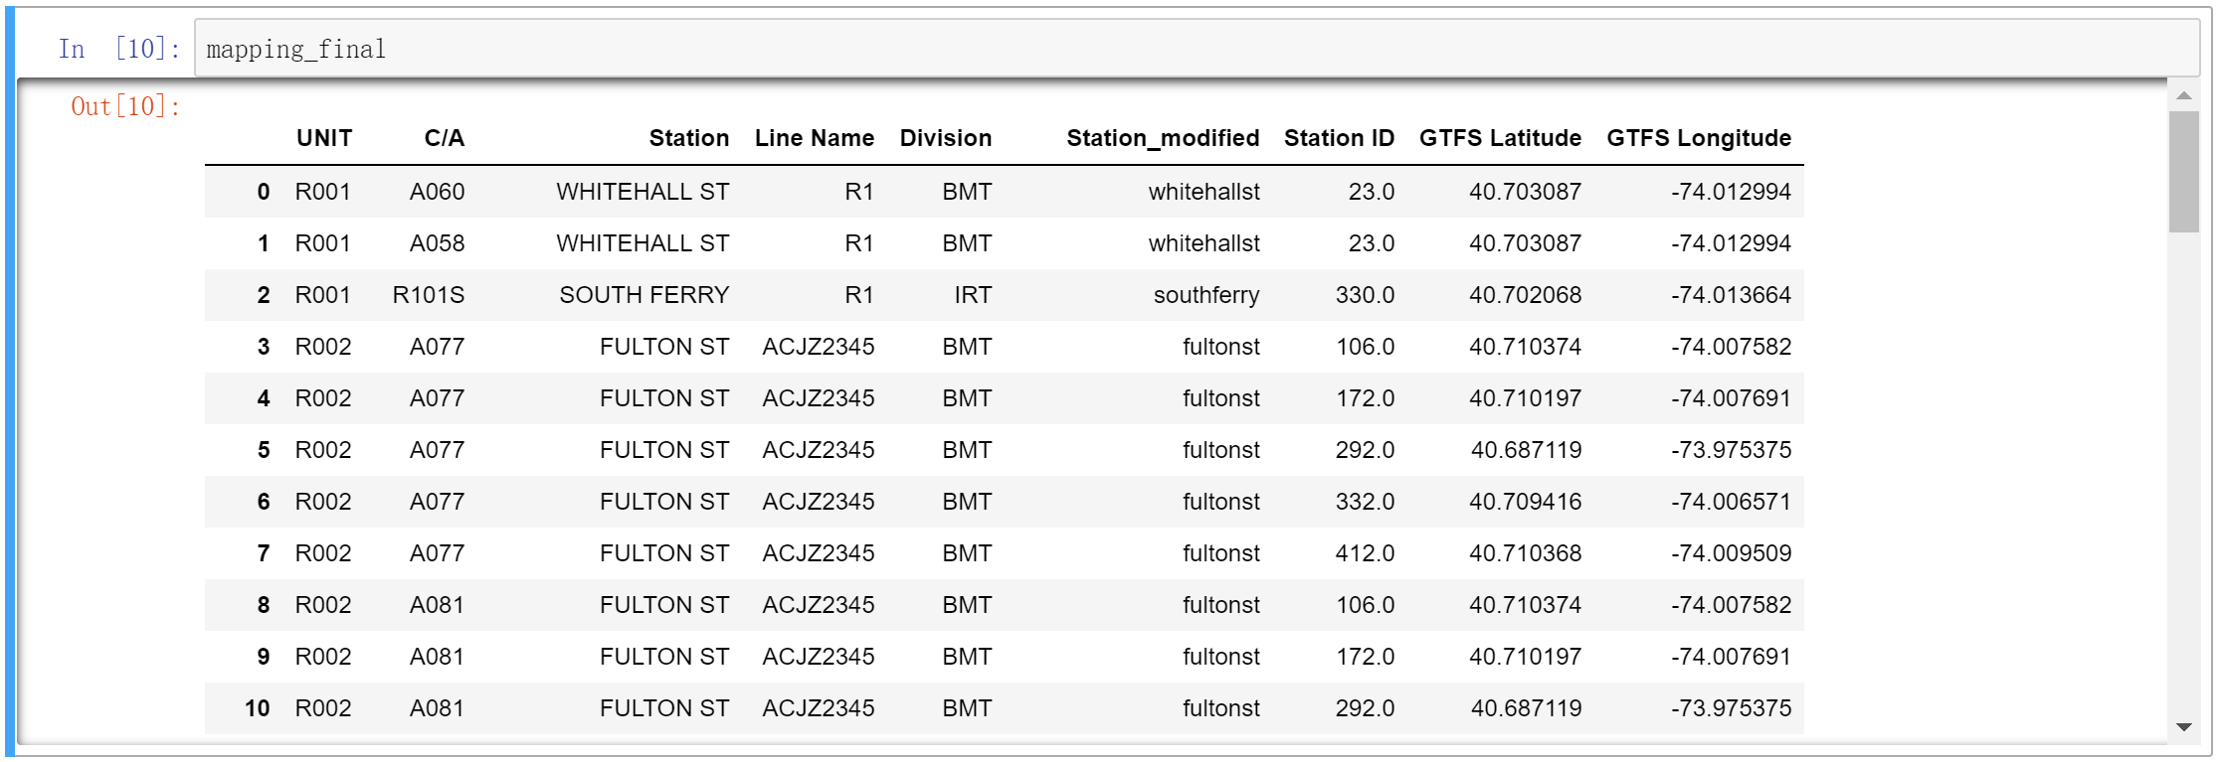

Slide 29
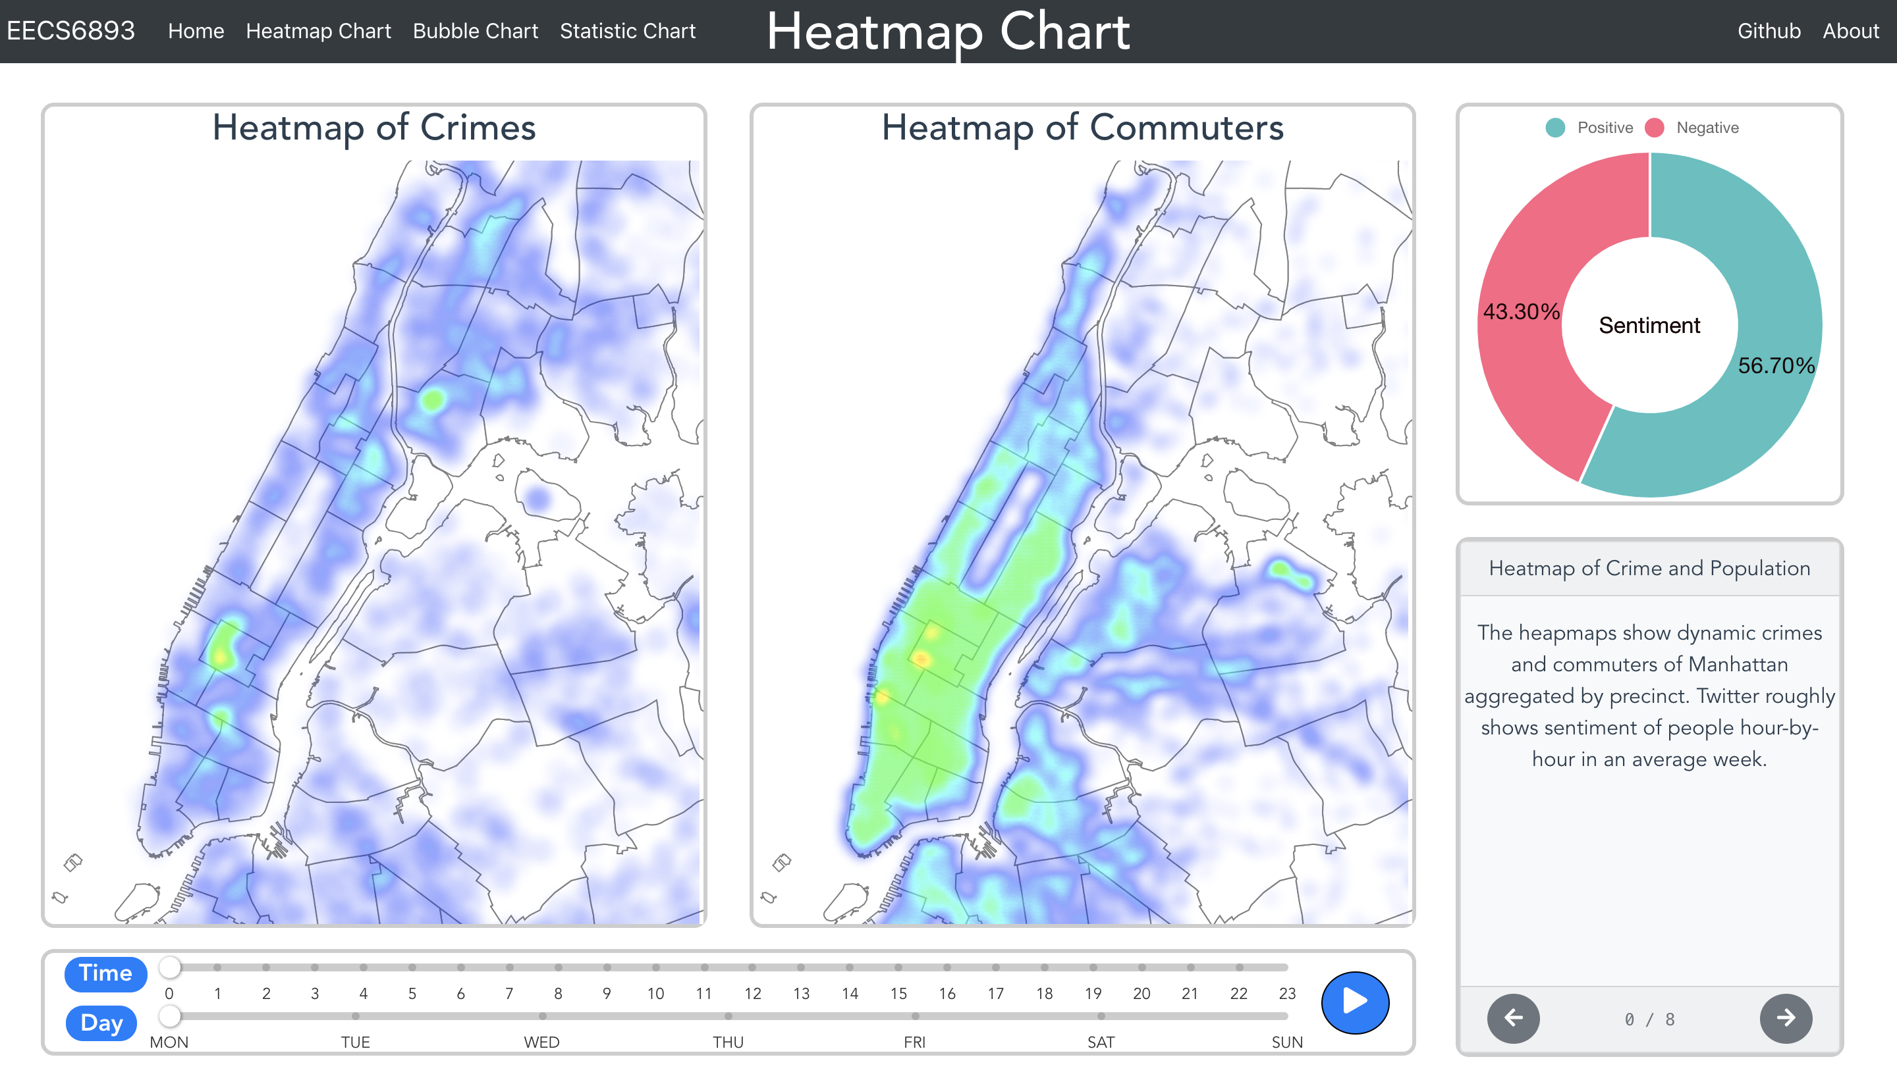
Appendix - Website

Slide 30
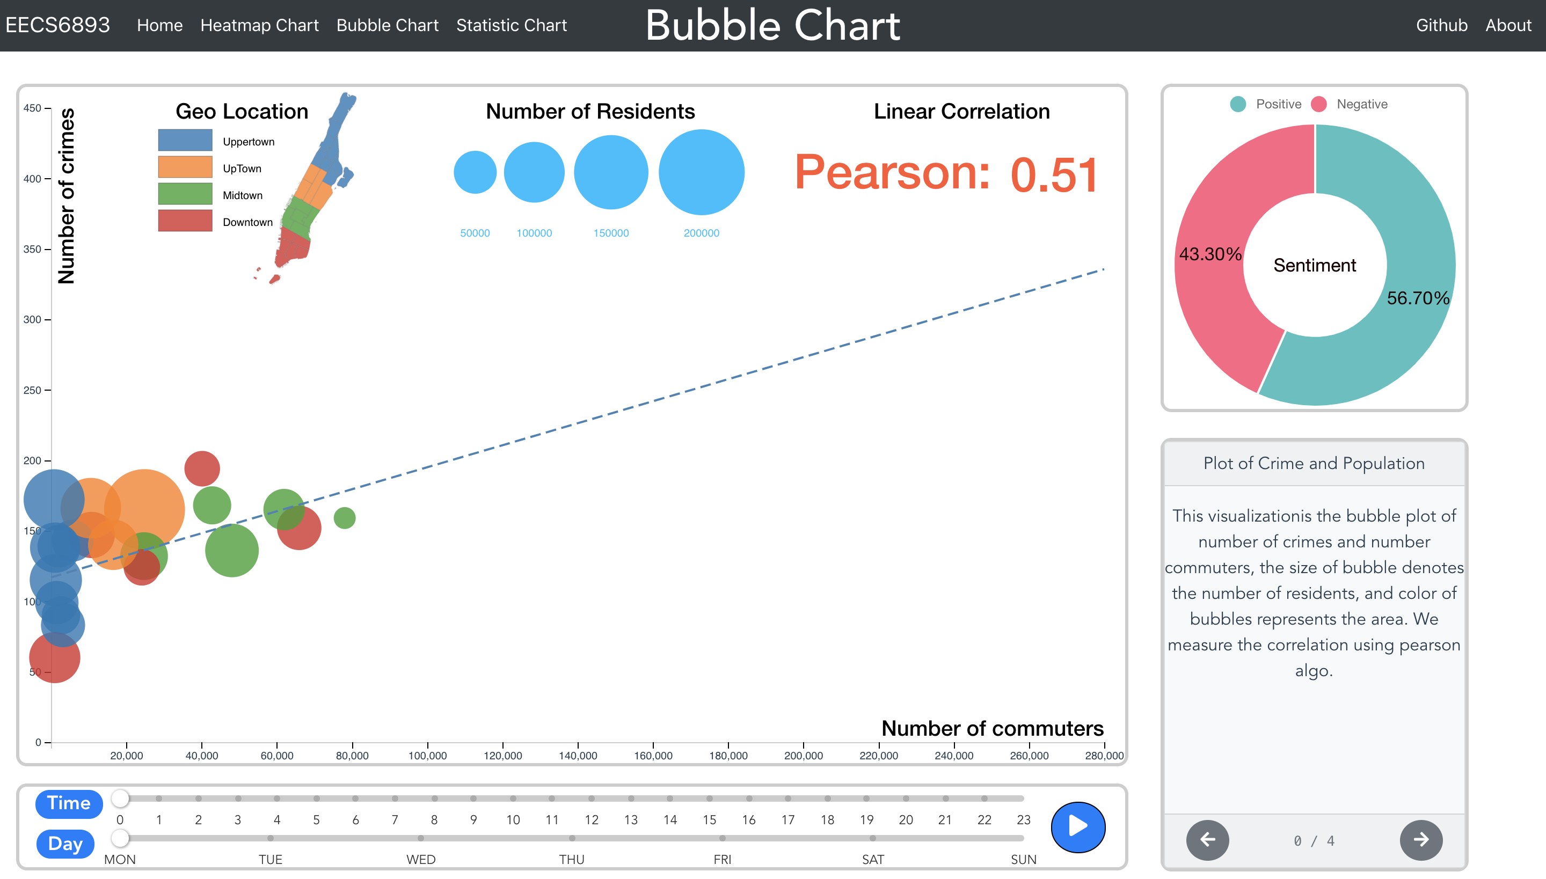

Slide 31
